Slide 1
Lab -11
Clustering
Machine Learning for Data Analysis DS-402
Link:https://vitalflux.com/k-means-clustering-explained-with-python-example/#:~:text=n_init%20(default%20as%2010)%3A,of%20iterations%20for%20each%20run.

Slide 2
How K-Means Clustering works
Choose the number of clusters k
Select k random points from the data as centroids
Assign all the points to the closest cluster centroid
Recompute the centroids of newly formed clusters
Repeat steps 3 and 4

Slide 3
Import the relevant Python libraries
Import the data
Read / clean / adjust the data (if needed)
Construct Clusters and
Predict the Cluster
Evaluate the accuracy

Slide 4
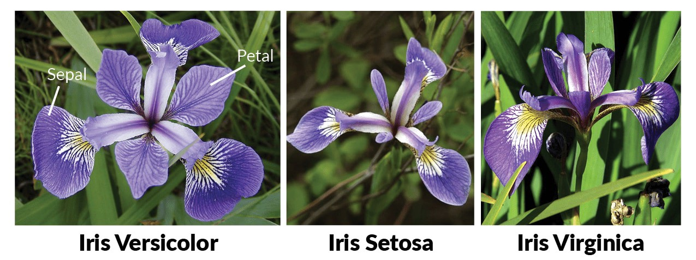
Clustering problem
source image:https://miro.medium.com/max/2550/0*GVjzZeYrir0R_6-X.png

Slide 5
Task
Do the same task with a new clustering problem and write the interpretation of the results.
Find results with changing values of k and write your observations.
Go through the link given on slide 01 and find silhoute score to check accuracy of the final clustering.

